Slide 1
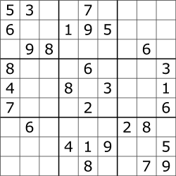
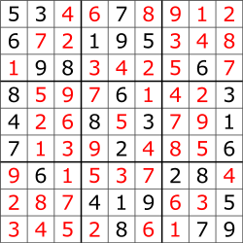
Example: solving Sudoku’s using PL
Formulate the problem as Constraints:
all squares must have exactly one number from 1-9
no number can appear twice in a row, column or square
https://sudoku.cool/mini-sudoku.php

Slide 2
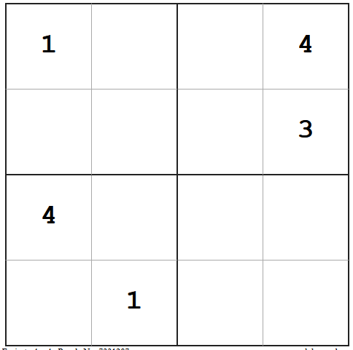
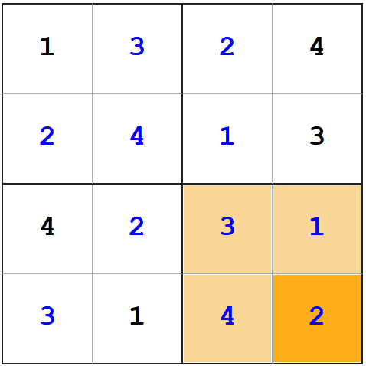
Example: solving Sudoku’s using PL
Formulate the problem as Constraints:
all squares must have precisely one number from 1-4
no number can appear twice in a row, column or square
https://sudoku.cool/mini-sudoku.php

Slide 3
How to write the constraints in PL?
We need to describe “the world”: one simple statement (“proposition”) for each value in each position on the board position_❶_❹_is_4, position_❹_❷_is_1 in short: 144, 421, ….
This puzzle is described as 111 ∧ 144 ∧ 243 ∧ 314 ∧ 421
in total we need 16x4=64 predicates
 | ❶ | ❷ | ❸ | ❹
❶ | 1 |  |  | 4
❷ |  |  |  | 3
❸ | 4
❹ |  | 1

Slide 4
How to write the constraints in PL?
We need to describe the constraints:
At least one number in each square: “position ❶❶ is a 1 or a 2 or 3 or a 4” 111 ∨ 112 ∨ 113 ∨ 114 (16 statements, one for each cell)
At most one number in each square: (4x16=64 statements) “if position ❶❶ is a 1 it is not a 2 and it is not a 3 and …”
111 -> ¬112 ∧ ¬ 113 ∧ ¬ 114
112 -> ¬111 ∧ ¬ 113 ∧ ¬ 114
113 -> ¬111 ∧ ¬ 112 ∧ ¬ 114
114 -> ¬111 ∧ ¬ 112 ∧ ¬ 113
 | ❶ | ❷ | ❸ | ❹
❶ | 1 |  |  | 4
❷ |  |  |  | 3
❸ | 4
❹ |  | 1

Slide 5
How to write the constraints in PL?
No number appears twice in a row: (4x16=64 statements 111 -> ¬121 ∧ ¬ 131 ∧ ¬ 141 112 -> ¬122 ∧ ¬ 132 ∧ ¬ 142 113 -> ¬123 ∧ ¬ 133 ∧ ¬ 143 114 -> ¬124 ∧ ¬ 134 ∧ ¬ 144
No number appears twice in a column” (again 64 statements) 111 -> ¬211 ∧ ¬ 311 ∧ ¬ 411 112 -> ¬212 ∧ ¬ 312 ∧ ¬ 412 113 -> ¬213 ∧ ¬ 313 ∧ ¬ 413 114 -> ¬214 ∧ ¬ 314 ∧ ¬ 414 No number appears twice in a box” (64x) 111 -> ¬121 ∧ ¬ 211 ∧ ¬ 221 112 -> ¬122 ∧ ¬ 212 ∧ ¬ 222 113 -> ¬123 ∧ ¬ 213 ∧ ¬ 223 114 -> ¬124 ∧ ¬ 214 ∧ ¬ 224
 | ❶ | ❷ | ❸ | ❹
❶ | 1 |  |  | 4
❷ |  |  |  | 3
❸ | 4
❹ |  | 1

Slide 6
How to write the constraints in PL?
In total: 64 variables, 4x64+16=272 statements
We have to write the given numbers: 111 ∧ 144 ∧ 243 ∧ 314 ∧ 422
All of these have to be put in clausal form: 111 -> ¬112 ∧ ¬ 113 ∧ ¬ 114
= (¬111 ∨ ¬112 ) ∧ (¬111 ∨ ¬ 113) ∧ (¬111 ∨ ¬ 114)
Read: http://anytime.cs.umass.edu/aimath06/proceedings/P34.pdf
 | ❶ | ❷ | ❸ | ❹
❶ | 1 |  |  | 4
❷ |  |  |  | 3
❸ | 4
❹ |  | 1

Slide 7
So now our puzzle is:
111 ∧ 144 ∧ 243 ∧ 314 ∧ 422
(¬111 ∨ ¬112 ) ∧ (¬111 ∨ ¬ 113) ∧ (¬111 ∨ ¬ 114)
….
…..
And we can ask: “can we find a truth-assignment to all predicates which makes all these statements true”
How do we find such a truth-assignment?
Two methods: truth-tables & Davis-Putnam: Truth tables = 2⁶⁴ rows = 18,446,744,073,709,551,616 = 18 billion billion… So let’s try Davis-Putnam!
272
 | ❶ | ❷ | ❸ | ❹
❶ | 1 |  |  | 4
❷ |  |  |  | 3
❸ | 4
❹ |  | 1

Slide 8
Davis-Putnam: an efficient procedure to find satisfying truth assignments
[see the slides of the Simplified lecture on Davis-Putnam procedure ]
You can experiment with Java Sudoku Solver (bob-carpenter.github.io) https://bob-carpenter.github.io/games/sudoku/java_sudoku.html
Your homework is https://www.cs.vu.nl/~frankh/spool/homework.html

